Slide 1


FINE-TUNING OF OPEN-SOURCE MODELS USING PEFT/LORA

Slide 2





Project Overview
In previous projects, we used pre-trained LLMs off-the-shelf models. Now, let’s dive into fine-tuning pre-trained LLM to perform exceptionally well on a specific task and dataset.
LLM fine-tuning refers to the process of adapting a pre-trained LLM to perform a specific task or address a particular domain using a smaller, task-specific dataset.
Fine-tuning adjusts the model's weights to better align it with the desired outcomes for the new use case, leveraging the general knowledge the model already acquired during its initial training.
Base Pre-Trained Model
Fine-Tuned Model
© All rights reserved for Dr. Ryan Ahmed @Stemplicity Inc.
Supervised Fine-Tuning
News Sentiment Data

Slide 3

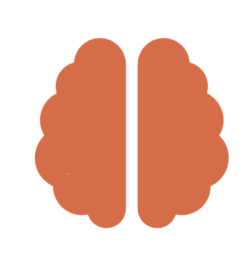
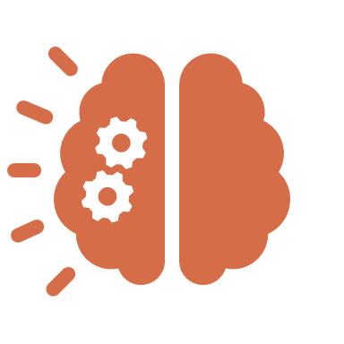

LLM Fine-Tuning: Example
A healthcare company fine-tunes a pre-trained model on medical reports and patient notes, enabling it to generate accurate, coherent patient reports tailored for healthcare professionals.
Joint pain, sun sensitivity, skin rash?
Joint pain, sun sensitivity, skin rash?
© All rights reserved for Dr. Ryan Ahmed @Stemplicity Inc.
Base LLM
Fine-tuned LLM
Allergy
Could be lupus erythematosus, an autoimmune disease. You should visit a rheumatologist.

Slide 4

Key Learning Outcomes
Learn when and why to fine-tune pre-trained models to adapt them to specific tasks or specialized domains.
Understand how parameter-efficient fine-tuning methods like LoRA make it possible to adapt large models using limited hardware, such as Colab GPUs.
Use tools like Hugging Face’s trl and SFTTrainer to fine-tune transformer models for supervised learning tasks such as classification.
Prepare datasets in the correct format for Hugging Face fine-tuning pipelines.
Evaluate model performance by calculating accuracy, precision, recall, and F1-score using the scikit-learn library.
© All rights reserved for Dr. Ryan Ahmed @Stemplicity Inc.

Slide 5
LOW-RANK ADAPTATION (LORA)

Slide 6
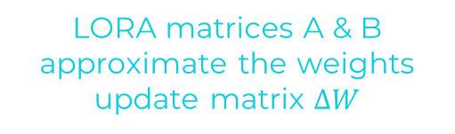

Low Rank Adaptation (LORA)
LoRA is a technique used in LLMs to reduce the computational cost and memory requirements by adapting only a small subset of the model parameters during fine-tuning.
Weight Update in Regular fine-Tuning
Weight Update in LORA
LORA matrices A & B approximate the weights update matrix $∆W$
Outputs
Outputs
+
+
Pretrained Weights
W
Weight
Update
$∆$W
Pretrained Weights
W
B
© All rights reserved for Dr. Ryan Ahmed @Stemplicity Inc.
r
A
d
Inputs
Inputs
d
Ex: If ΔW has 10,000 rows and 20,000 columns, it stores 200,000,000 parameters. If we choose A and B with r=8, then A has 10,000 rows and 8 columns, and B has 8 rows and 20,000 columns, that's 10,000×8 + 8×20,000 = 240,000 parameters, which is 830× less than 200,000,000.

Slide 7
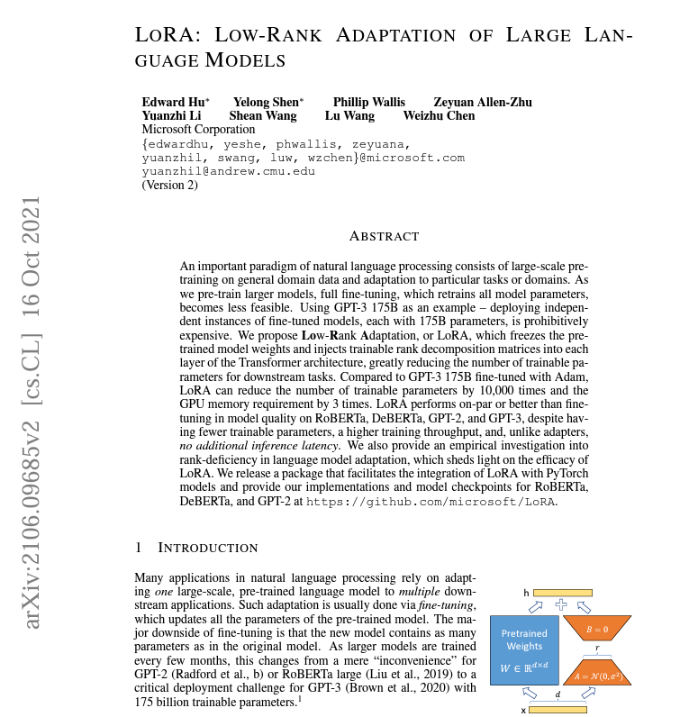
LORA Paper
Paper: https://arxiv.org/abs/2106.09685
© All rights reserved for Dr. Ryan Ahmed @Stemplicity Inc.

Slide 8
CONFUSION MATRIX & CLASSIFICATION KPIs

Slide 9
Confusion Matrix
A confusion matrix is a table layout that visualizes the performance of supervised machine learning classification models.
The confusion matrix displays the number of correct and incorrect predictions compared to the ground truth (actual) outcomes.
Actual Labels (Ground Truth)
Class “1”
Class “0”
© All rights reserved for Dr. Ryan Ahmed @Stemplicity Inc.
True
Positives (TP)
False Positives (FP)
Type I Error
Class “1”
Predicted Results
False Negatives (FN)
Type II Error
True
Negatives (TN)
Class “0”

Slide 10
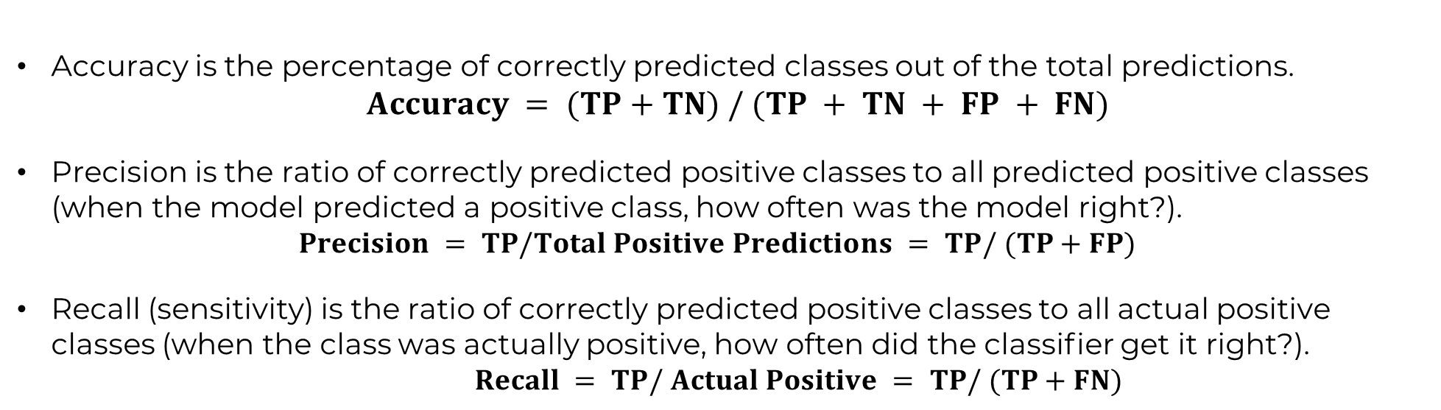
Accuracy, Precision and Recall
Accuracy is the percentage of correctly predicted classes out of the total predictions.
$$Accuracy = (TP+TN) / (TP + TN + FP + FN)$$
Precision is the ratio of correctly predicted positive classes to all predicted positive classes (when the model predicted a positive class, how often was the model right?).
$$Precision = TP/Total Positive Predictions = TP/ (TP+FP)$$
Recall (sensitivity) is the ratio of correctly predicted positive classes to all actual positive classes (when the class was actually positive, how often did the classiﬁer get it right?).
$$Recall = TP/ Actual Positive = TP/ (TP+FN)$$
© All rights reserved for Dr. Ryan Ahmed @Stemplicity Inc.

Slide 11
Accuracy, Precision and Recall: Example
Assume that we have 100 patients; 91 of these patients are healthy, and 9 have diabetes.
We trained a machine learning classifier model, and the results are presented in the confusion matrix below.
Actual Labels
Class “1”
Class “0”
Class “1”
TP = 1
FP = 1
© All rights reserved for Dr. Ryan Ahmed @Stemplicity Inc.
Predicted Results
Class “0”
FN = 8
TN = 90
Accuracy = (TP+TN) / (TP + TN + FP + FN) = 91%
Precision = TP/Total Positive Predictions = TP/ (TP+FP) = 1/2 = 50%
Recall = TP/ Actual Positive = TP/ (TP+FN) = 1/9 = 11%

Slide 12

Summary
Learned the importance of fine-tuning pre-trained models to tailor them for domain-specific tasks, improving their performance and relevance.
Gained insight into using parameter-efficient methods like LoRA to fine-tune large models affordably on limited hardware such as Google Colab.
Explored Hugging Face’s trl and SFTTrainer libraries as streamlined tools for supervised learning tasks like classification.
Understood the necessity of properly formatting datasets to ensure compatibility and smooth training with Hugging Face pipelines.
Developed skills to assess model effectiveness using metrics like accuracy, precision, recall, and F1-score with the scikit-learn library.
© All rights reserved for Dr. Ryan Ahmed @Stemplicity Inc.

Slide 13
Thank you!

